Slide 1
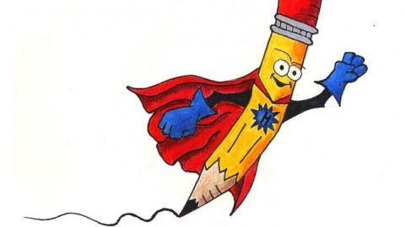
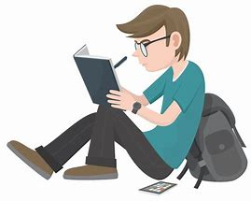
Writing

Slide 2
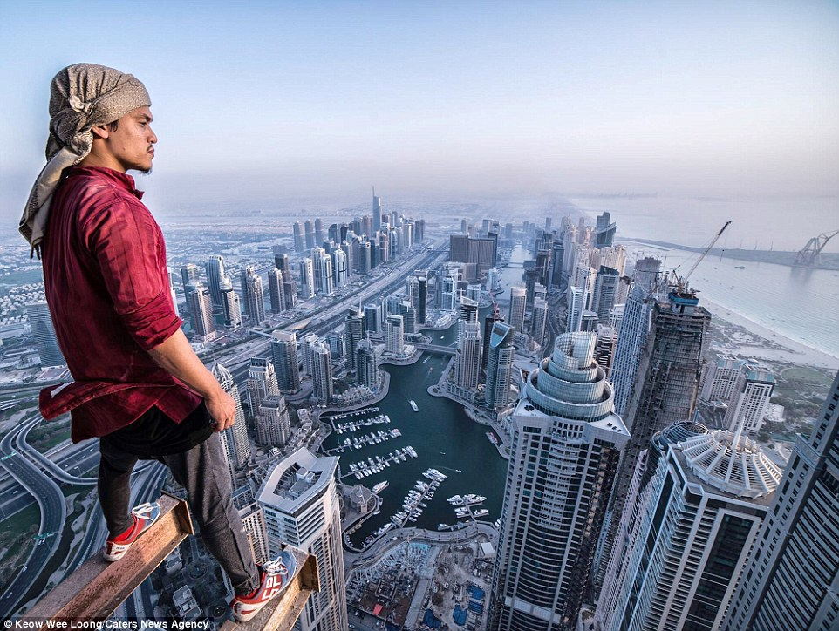
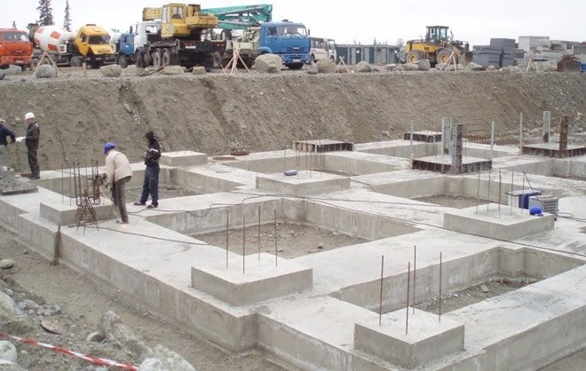
Successful writing has many levels
To get to the top…
You must get the foundations right

Slide 3
What makes good writing?
Spelling
Punctuation
Sentences
Paragraphs
Planning
Language Choices
Checking

Slide 4
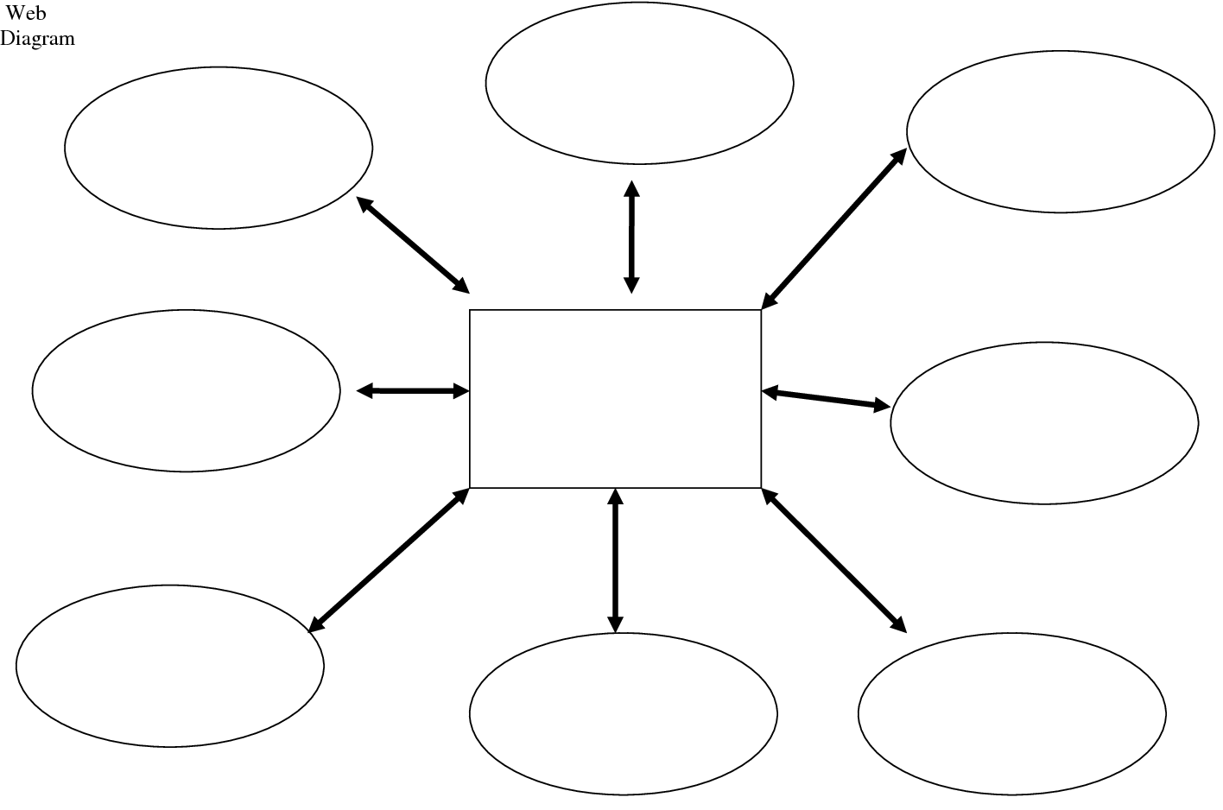
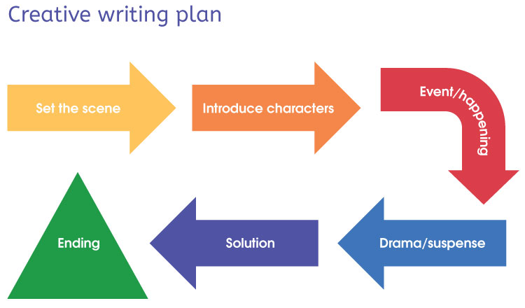
Planning
Bullet point list
Spider diagram
Flowchart

Slide 5
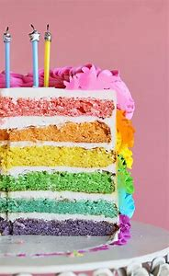
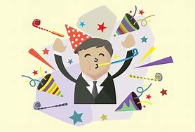
Really enjoyed it
Birthday
Cake
No party!!
Lots of candles
An Exciting Surprise
Getting old
Hate surprises
Setting
Decoy
restaurant
Warned family
Family and Friends
Away for the day
Unexpected
Relief
Entrance to restaurant
Complete shock
Shaking

Slide 6
Writing a story opening:
The objective is to make the reader want to keep reading
Make it dramatic, informative or exciting using at least one of the 4 components discussed.
Describing a character
Describing a setting
Start with an action
Start with some dialogue

Slide 7
Setting:
Could you give the reader information about the setting:–
Where and when is it based? What time of year (or season)
What can you see, hear, smell or touch?
What would the audience see if they were standing there?

Slide 8
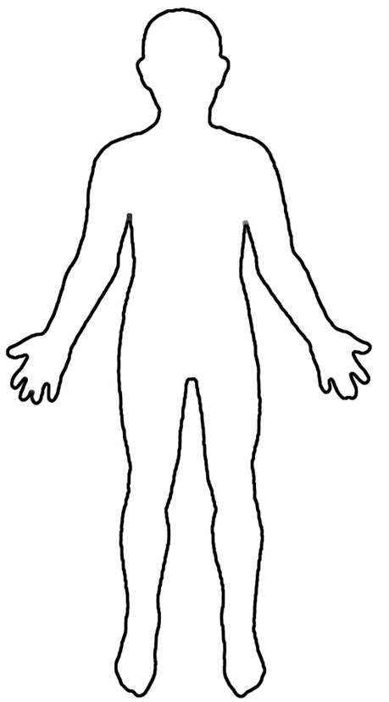
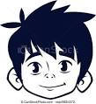
Character:
Could you introduce a character (or more than one)? Tell the audience about character, their name, something about them that is relevant to the story.
Could you tell us about their past, something interesting that will be impact on what happens? Or something that will explain why something will happen?
If you are writing about conflict it could be about their experience of the war, how it has affected their family

Slide 9
Action
Could you start the story with an interesting action that sets up something that will happen?
Boom!! The bombs exploded around me … Wrrrrrrrrrrrrrrrrrrrhhhhhhhhh. The air raid siren wailed to warn us of the impending danger.

Slide 10
Dialogue
Could you show us a conversation that a character may have that tells us a little about what might happen? Or something that suggests a possible storyline, or leaves the reader with a question?
“But Mum, I don’t want to stay at Grandma’s! She has weird things in her house and it is really spooky. It almost feels like the painting s are watching me…”

Slide 11
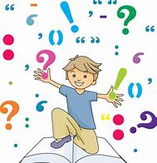
Punctuation Marks

Slide 12
Punctuation Marks
Thousands of years ago people did not leave gaps between words. Later they started leaving spaces and using punctuation marks.
Ifyoudontleavespaceswritinglookssilly
Without punctuation, writing is hard to understand.

Slide 14
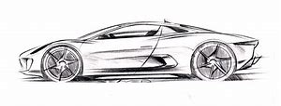
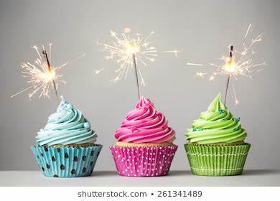
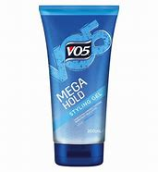
Simple Sentences
A simple sentence is one which contains only one piece of information, or tells us only one thing. It has one verb.
Aidan loved his car.
Ethan bought some new hair gel.
Aimee ate three cakes!

Slide 15
Compound Sentences
A compound sentence is one in which you join two simple sentences together. Often we use the words ‘and’, ‘but’, or ‘so’ to do this. These words are called conjunctions.
Aidan loved his car and polished it every day.
Ethan bought new hair gel but it didn’t work very well.
Aimee ate three cakes so…

Slide 16
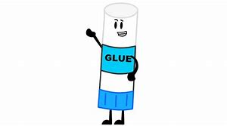
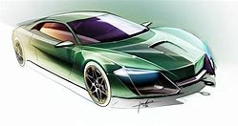
Complex Sentences
A complex sentence is one in which you glue extra information into a sentence. We call the original sentence the main clause, and the extra part the subordinate clause.
Aidan loved his car, which was green.
Although he tried hard, Ethan couldn’t get his hair right.

Slide 17
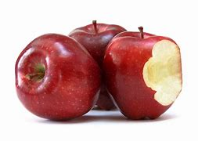
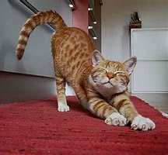
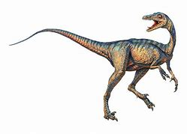
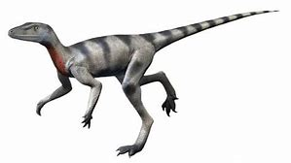
Simple, compound, or complex?
1. The cat stretched and ate his food.
2. Only apples grow on apple trees.
3. If you want to succeed, which I’m sure you do, you will have to work hard.
4. The little dinosaur, small though it was, still looked scary to me!
5. The rattling sound seemed to be coming from my waste paper bins.

Slide 18
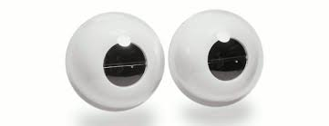
Blink test
Aaaaaaaaaaaaaaaaaaaaaaaaaaaaaaaaaaaaaaaaaaaaaaaaaaaaaaaaaaaaaaaaaaaaaaaaaaa
Aaaaaaaaaaaaaaaaaaaaaaaaaaaaaaaaaaaaaaaaaaaaaaaaaaaaaaaaaaaaaaaaaaaaaaaaaaa
aaaaaaaaaaaaaaaaaaaaaaaaaaaaaaaaaaaaaaaaaaaaaaaaaaaaaaaaaaaaaaaaaaaaaaaaaaa
Bbbbbbbbbbbbbbbbbbbbbbbbbbbbbbbbbbbbbbbbbbbbbbbbbbbbbbbbbbbbbbbbbbbbbbbbbbbbbbbbbbbbbbbbbbbbbbbbbbbbb
Bbbbbbbbbbbbbbbbbbbbbbbbbbb
Bbbbbbbbbbbbbbbbbbbbbbbbbbbbbbbbbbbbbbbbbbbbbbbbbbbbbbbbbbbbbbbbbbbbbbbbbbbbbbbbbbbbbbbbbbbbbbbbbbbbbbbbbbbbbbbbbbbbbbbbbbbbbbbbbbbbbbbbbbbbbbbbbbbbbbbbbbbbbbbbbbbbbbbbbbbbbbbbbbbbbbbbbbbbbbb
bbbbbbbbbbbbbbbbbbbbbbbbbbbbbbbbbbbbbbbbbbbbbbbbbbbbbbbbbbbbbbbbbbbbbbbbbbbbbb

Slide 19
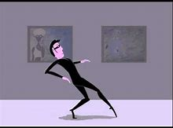
Language Choices
Adjectives
Adverbs
Verbs
Alliteration
Onomatopoeia
Simile
Metaphor
terrified dull glorious
sneakily bravely happily
whispered screamed hurled
sizzling sun
whizz
my jacket is sticking to me like a sharp knife
the man is a mountain

Slide 20
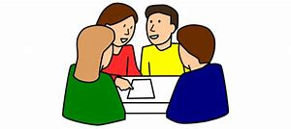
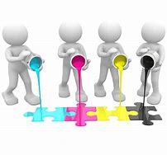
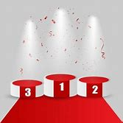
Group Activity
Read the sample of writing
What is good about them?
Place them in order 1-3

Slide 21
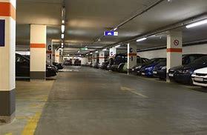
The Journey of My Life
My heart is beating. I feel alone. Cars beep at me as I walk out of the car park. Everywhere I look there is noise.
I walk back thirsty and grumpy. Tears roll from my eyes as I give up. The skin on my face is red as a rose.
I hear a voice. It sounds like my dad. Suddenly I see a person coming towards me. It could have been a stranger but it’s daddy! I found you, I found you!

Slide 22
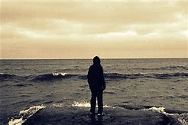
Lost at Sea!
It is a sizzling summer’s day. I’m playing with friends and family. Can this day get much better? Giggling and ice-cream equals fun. We all gather around the sea. ‘Jump in!’ I am in up to my neck…
Splashing about in the water, my life jacket is sticking to me like a sharp knife. Everyone gets out but why can I not? I see a wave come. Can I get away from it in time?
Up I come from underneath the water. I am lost! No one is around. The sun starts to disappear into the night sky. Will I ever find my family and friends?

Slide 23
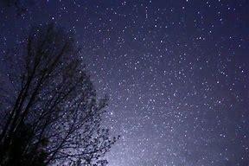
A Shadow in the Night.
Stars shine, lost in the night.
I run. The shadow is catching up. I am lost. I can feel the light blow of the wind upon my pale face. I hear the twigs beneath the shadows feet snap. The smell of ivy glides across my nose. I know I must hide, but all that is around me are trees. I have an idea.
Heart in the throat, not able to breathe, I climb up a tree. I can’t see it. The shadow has lost me, I think. No! It has had the same idea I had. It climbs up the next tree. I panic; I hide behind a bunch of leaves. I feel the leaves tickling against my face. It’s eyes whizz past me. I think I’m safe. It starts to climb down but all of a sudden I sneeze. I am as scared as an ant under an elephant’s foot. I fall. My bones ache and it comes towards me. It’s face lights up with glee.
Under the duvet, curtains closed, I start to see familiar colours. I know this sight but I can’t seem to realise where it is. I hear the toilet flush, the kettle’s on. I know where I am…I am in my double bed with my cosy pyjamas against my skin.
It was all a dream.

Slide 25
Storms brewed on the emotionless horizon promising nothing but winds to level even the mightiest of trees. Torrential rain poured down in icy sheets like needles upon my face. The wind didn’t howl, it screamed. The rain was not falling: it was driven, hard, merciless, torrential. The trees did not sway, they creaked, bent and moaned as their fine limbs were ripped away and their autumnal leaves became not confetti, but ammunition in the gale.

Slide 26
It’s a hot day and I really hate my brother.
We’re playing Scrabble, that’s how bad it is. It’s a blistering hot afternoon in August. The outside world has faded yellow like an old photograph left in the sun, my body is weak and exhausted from the heat and here we are playing, Scrabble.
My mum is making us play; she always does. My life is like one massive Scrabble game, gradually letter by letter building my life.

