Slide 1
Revision
Tips

Slide 2
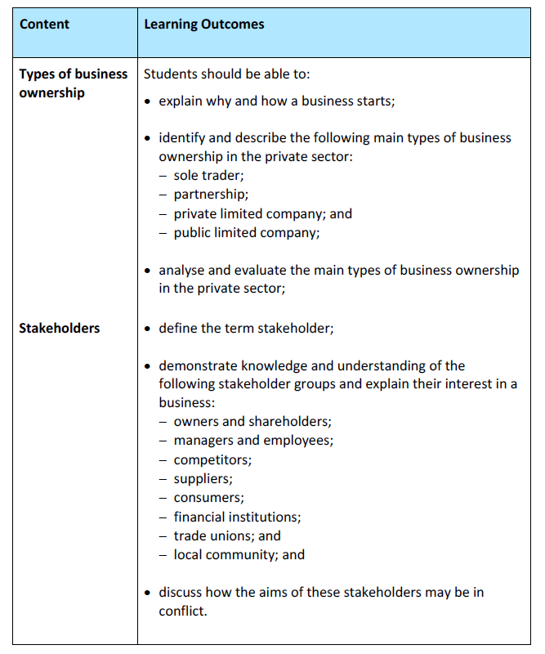
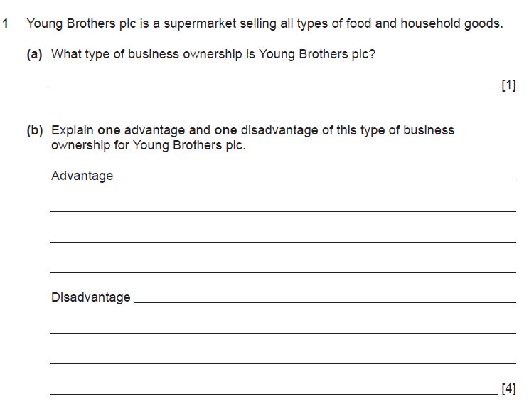
Five key tips to help you study…
No 1: Understand and use your GCSE/AS/A2 specification
It is very important to understand the key terminology that will be used in the questions.

Slide 3
No 2: Practise under exam conditions
Use your Past Paper Booklet and find a quiet space. Time yourself and then mark against the mark schemes available on Google Classroom/exam board website.

Slide 4
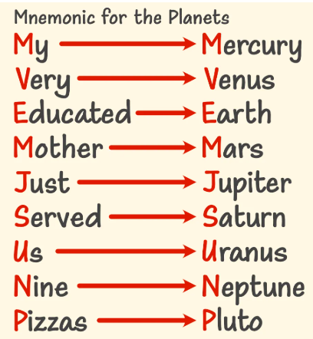
No 3: Explore different ways of learning
Visual learners learn best from visual images that do not include writing. Graphs and diagrams are easy for them to understand. They remember faces and places and tend to recall information by picturing it in their minds.
Techniques:
Diagrams/mind maps
Make flashcards that include pictures or diagrams as visual clues
Highlight key information in your texts or notes
Create a chart or a series of boxes to remind you how to complete math equations
Vocabulary mnemonics
Pin your notes up somewhere (eg bedroom) swap these over at intervals

Slide 5
No 3: Explore different ways of learning continued..
Aural or auditory learners do well with hearing information. They remember words to songs and can recall conversations in detail by hearing them in their minds.
Techniques:
Use a computer/phone to record your notes read aloud
Convert this information to download for iPod using iTunes
Read your notes aloud when studying
Work with a regular study partner to review out loud
Work in a group where you can discuss the information
When learning new material, especially equations, talk your way through the material
Singing/ creating a song
Mnemonic devices

Slide 6
No 3: Explore different ways of learning continued..
Reading/Writing learners are at home with written material. They comprehend and remember what they read, and they often enjoy writing.
Techniques:
Re-write your notes after class
Use coloured pens and highlighters to focus in on key ideas
Write out instructions for each step of a procedure or problem
Post note cards/post-its in visible places (when getting ready, on the bottom of the remote, etc.)
Vocab mnemonics
Repetitive writing

Slide 7
No 3: Explore different ways of learning continued..
Kinaesthetic learners learn by doing. Hands-on activities and real-life experiences help them remember.
Walk back and forth, move in some way, when studying notes
Type your notes after class
Create a YouTube video as a group to study later individually
Write your notes onto flashcards / make posters
Review flashcards while walking, at gym, etc
Sit near the front of the room
Read your notes out loud
Highlight material when reviewing/studying
Use a dry-erase or chalk board to study or review
Correlate physical movements with ideas/terms

Slide 8
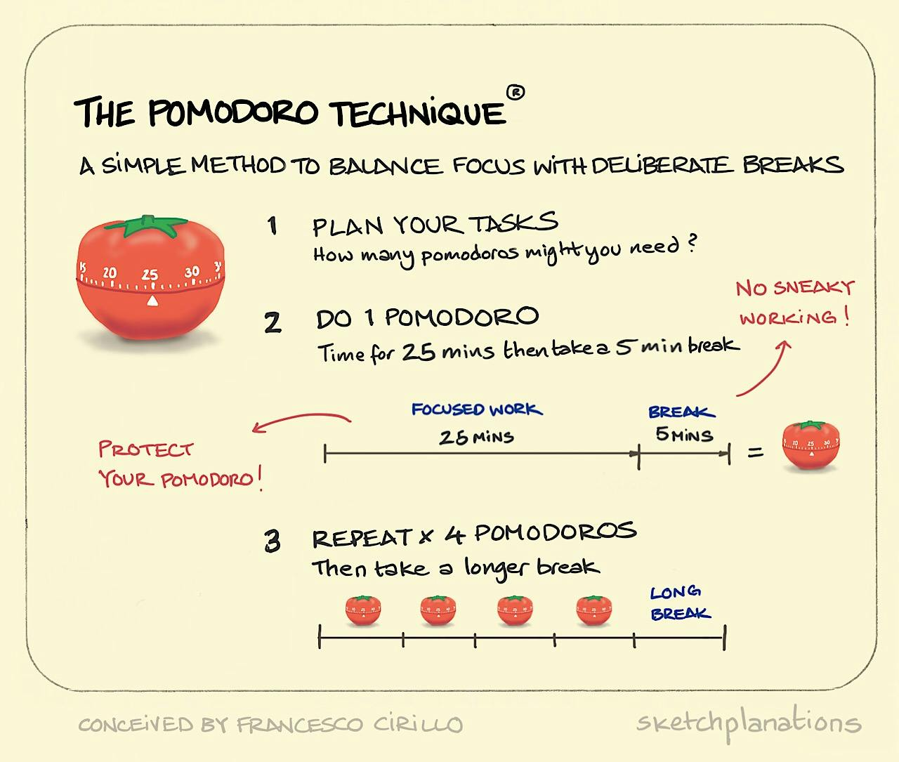
No 4: Foster self-discipline and motivation

Slide 9
Other things to consider…
Where you study is as important as how you study – get a quiet space
Practising the information, you’ve learned is the best way to retain information – keep going back to it
Make a timetable and stick to it
Reward yourself – plan something you enjoy

Slide 10
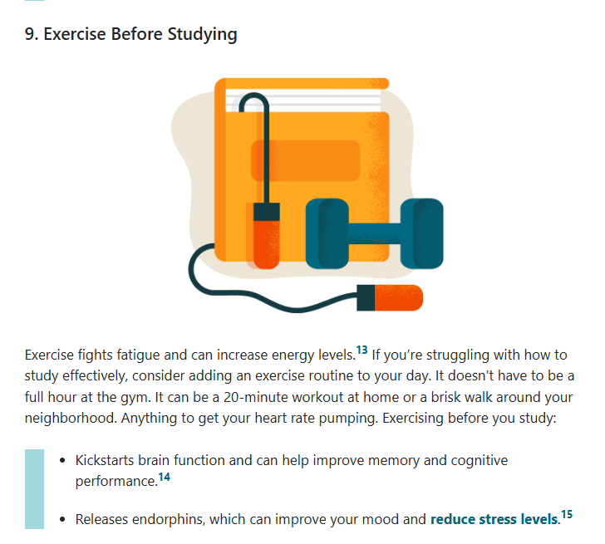
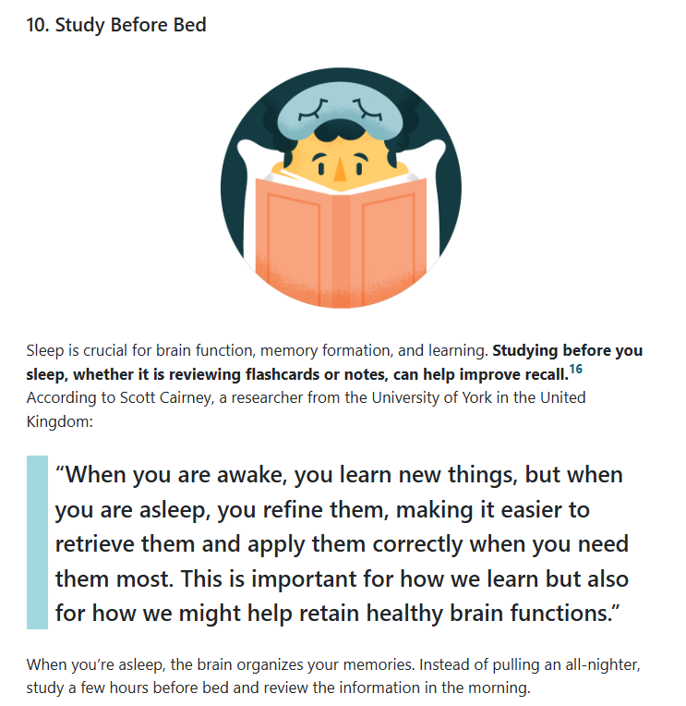
Research indicates that …

