Slide 1
Mysteries in History
St Pius X College Magherafelt

Slide 2
What is a mystery in History?
Something about the past that is difficult to work out or explain.

Slide 3
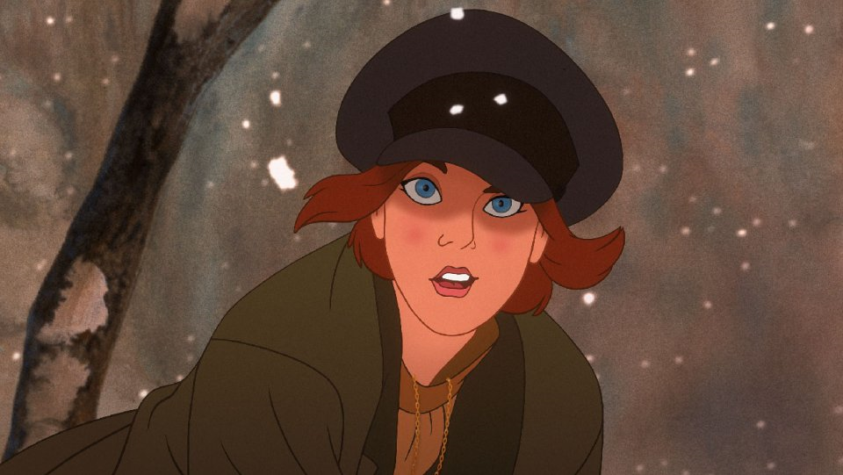
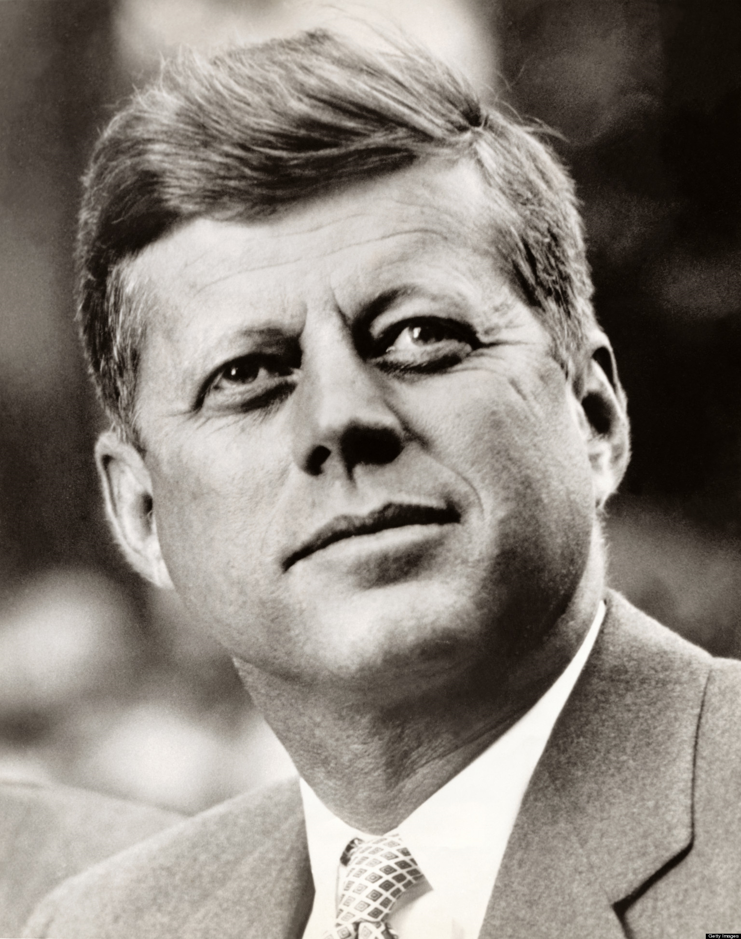
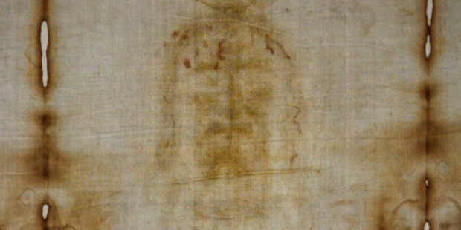
Examples:

Slide 4
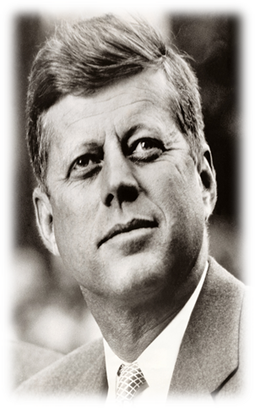
What do you believe?
- Look at the two assassinations. What do you think?
https://www.youtube.com/watch?v=9vLLUkA9q_I

Slide 5
Who is this?

Slide 6
What happened to Hitler?
1. He died in his bunker in 1945
2. He survived and lived out his life in South America

Slide 7
Your task:
Get into small groups
Look through the sources you are given and complete the sheet.
Discuss with your group and decide whether your group thinks Hitler died or survived WW2.

